Slide 1



YOU ARE A CLUB OFFICER
HOLD MULTIPLE OFFICERS POSITIONS IN A CLUB
HOLD MULTIPLE OFFICERS POSITIONS IN DIFFERENT CLUBS
HOLD ONE OFFICER POSITION
ONLY NEED 2 HOURS OF TRAINING TO MEET REQUIREMENTS
ANY OFFICER POSITION
Club Success Plan OR COMBINED OFFICERS OR JUDGES TRAINING
+
OFFICER TRAINING
Total of 2 hours

Slide 2
Club Success Plan
Please “re-name” yourself to include your role
(Example: VPE Sandy Chen)
Receive slides and example in chat

Slide 3




Recognize
Assess
Develop
Recognize the advantages to good planning
Assess and revise planning documents to improve effectiveness
Develop planning documents to effectively target goals

Slide 4
10 Reasons to Participate in DCP
Enables the club to fulfill its mission which is to provide the environment in which members can develop their communication and leadership skills.
Ensures the club provides a quality “product” – the club meeting – for its members.
Results in satisfied members who are learning communication and leadership skills.
Gives members the opportunity to learn planning skills useful in business and community life.

Slide 5
10 Reasons to Participate in DCP
Provides a sense of achievements to those clubs that are successful in it.
Gives members and club officers the opportunity to learn the value of teamwork as they work together to achieve DCP goals.
Keeps the club focused on providing a good educational program.
Reminds clubs that new members bring new ideas and new personalities.

Slide 6
10 Reasons to Participate in DCP
Allows the clubs to be recognized for its achievements in the DCP.
Provides a road map for success.
“The DCP Roadmap,” JoAnna McWilliams, International President, 2000-2001, The Toastmaster, June 2001

Slide 7
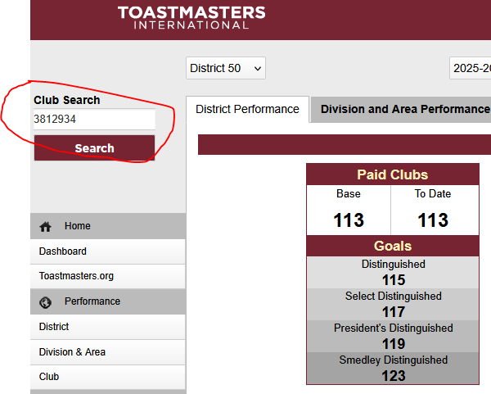
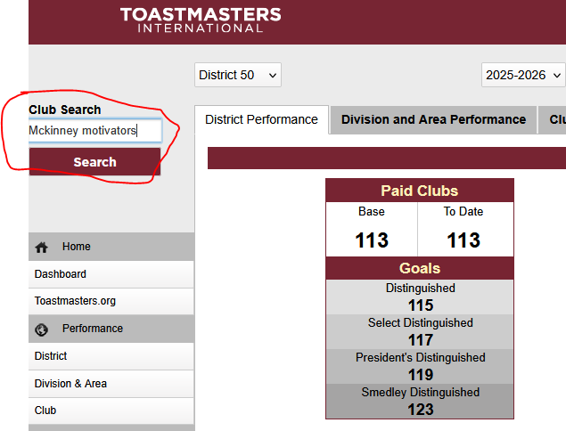
Distinguished Performance Reports

Slide 8
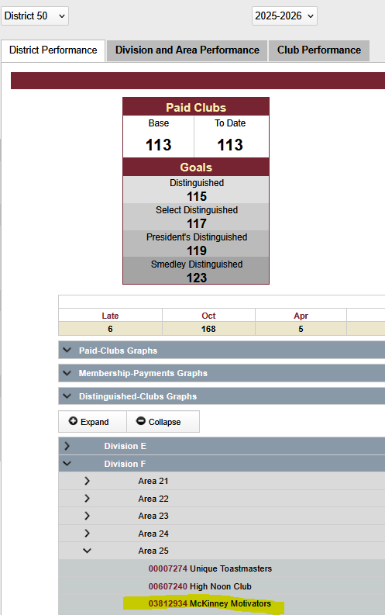
Distinguished Performance Report—McKinney Motivators
Scroll down the Dashboard through Division and Area to the Club.

Slide 9
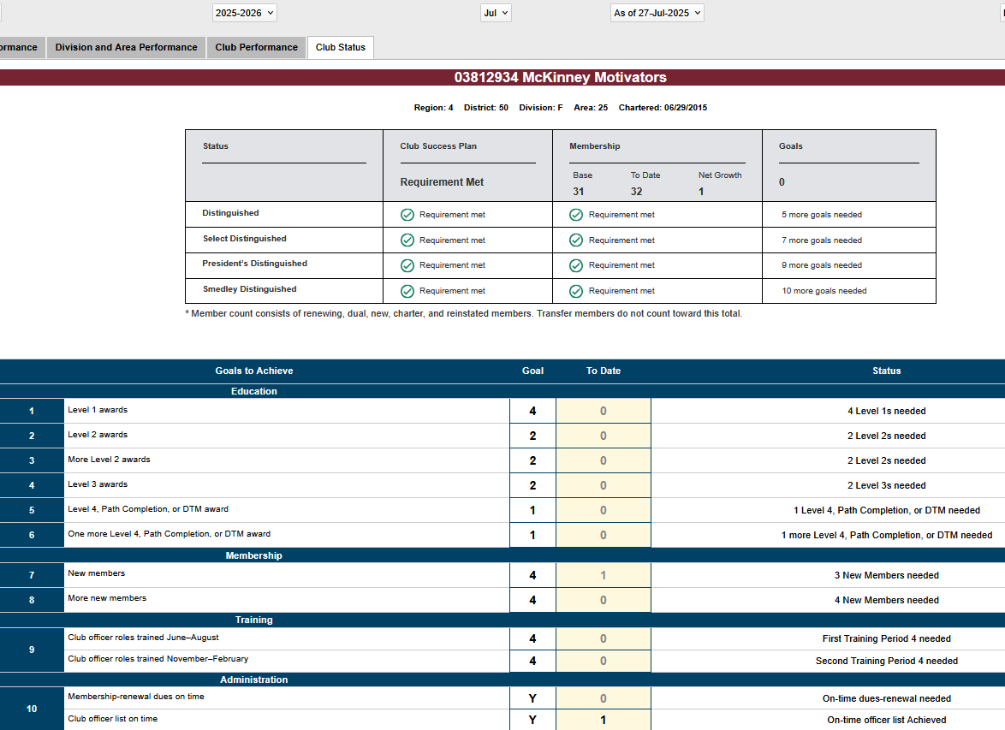

Slide 10
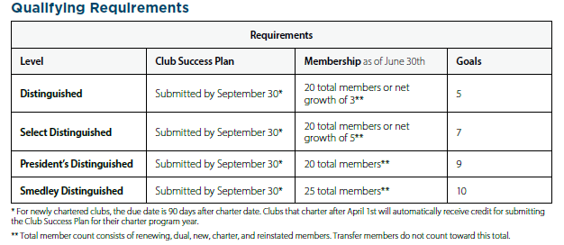

Slide 11
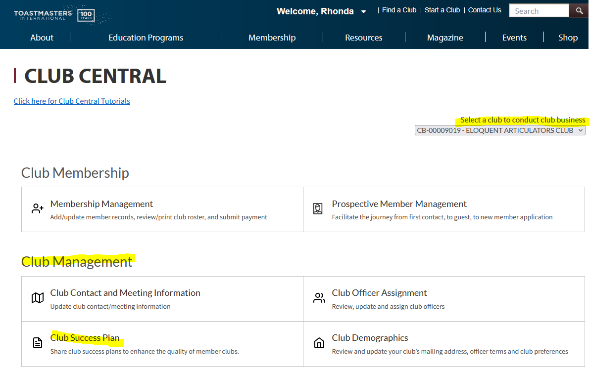

Slide 12
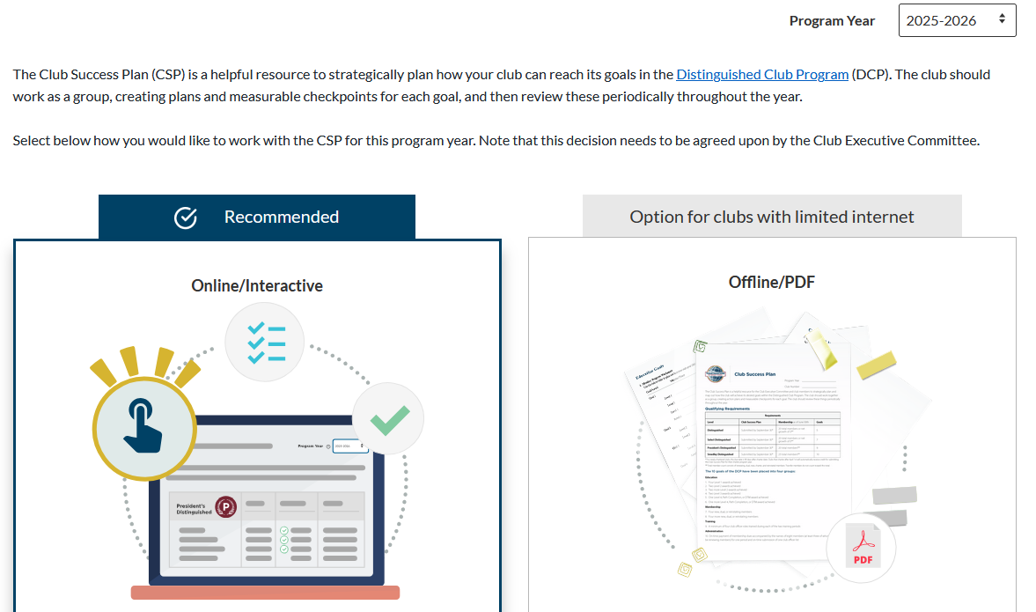
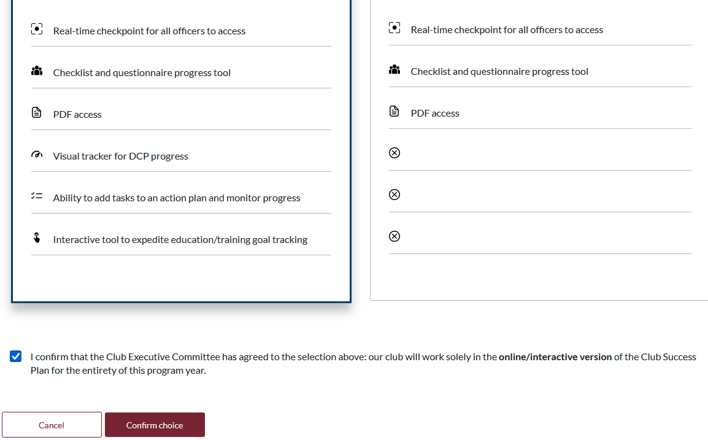

Slide 13
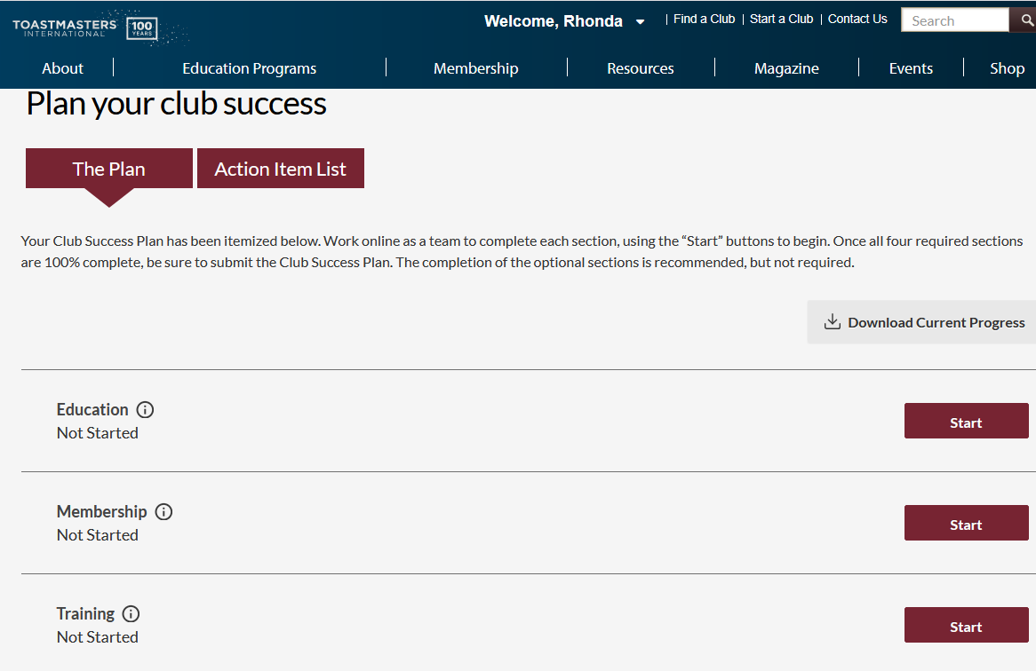
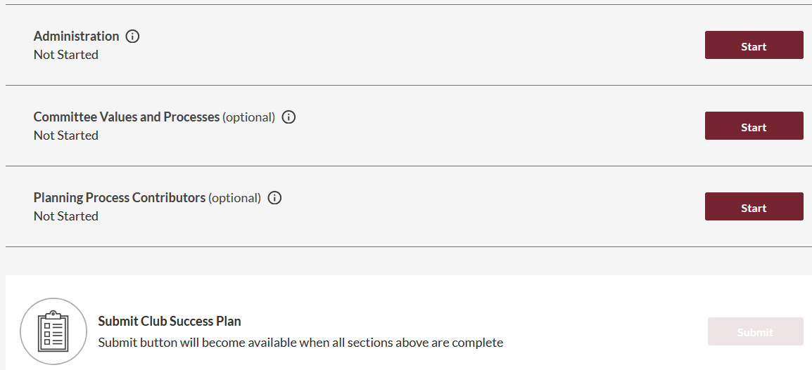

Slide 14
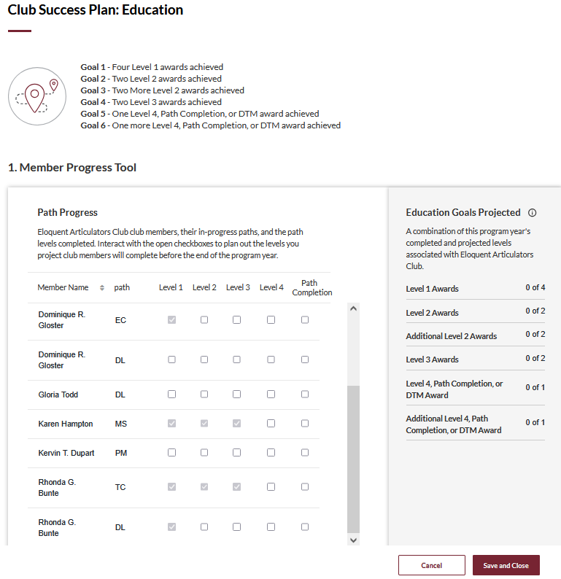

Slide 15
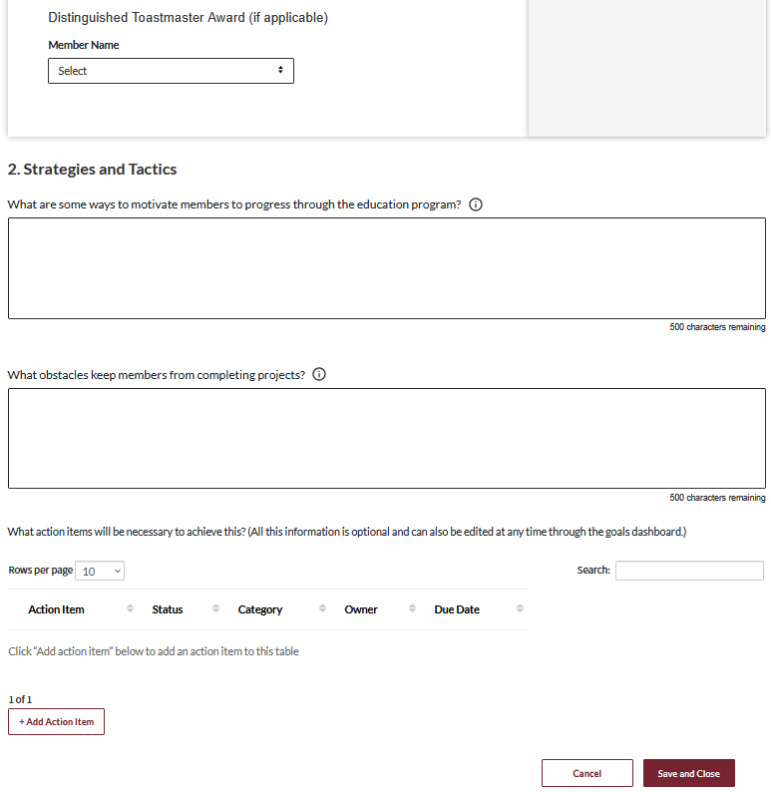

Slide 16
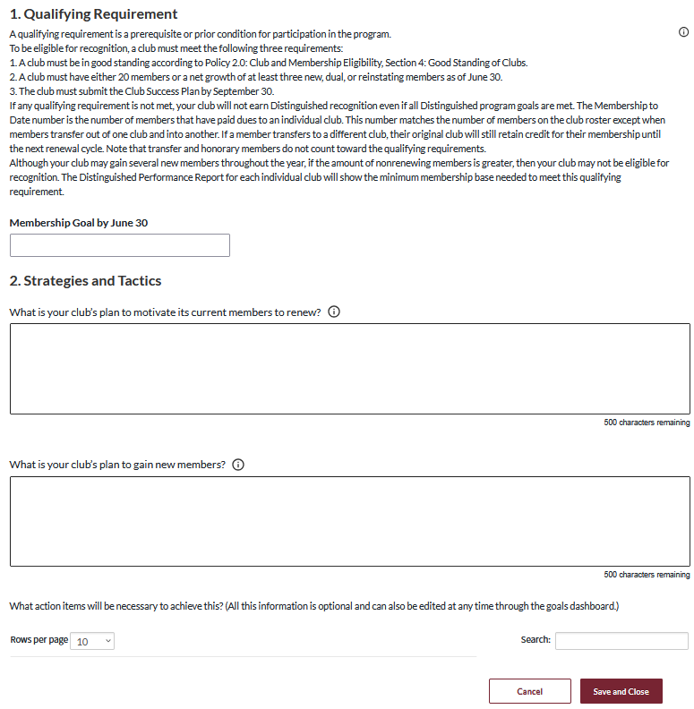

Slide 17
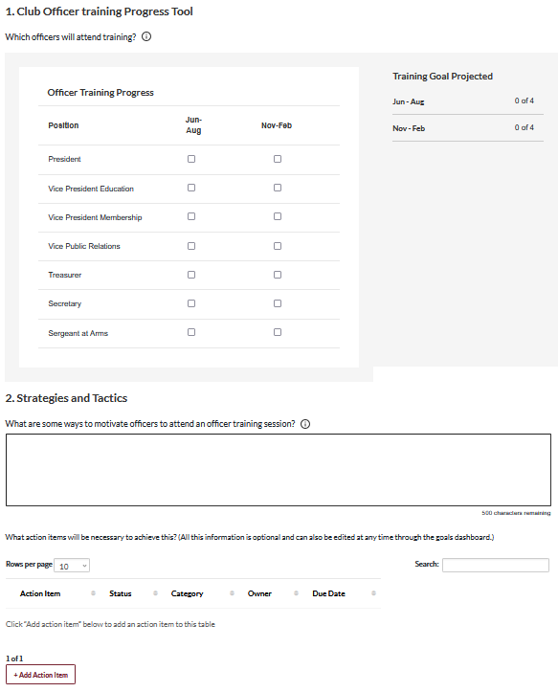

Slide 18
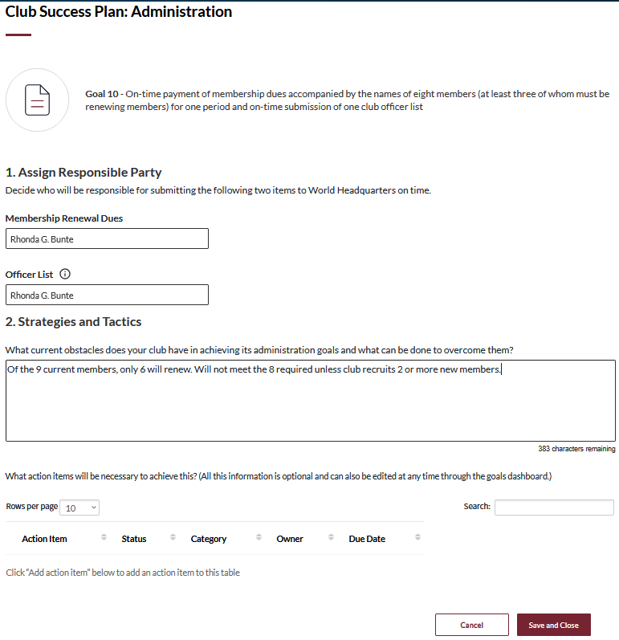

Slide 19
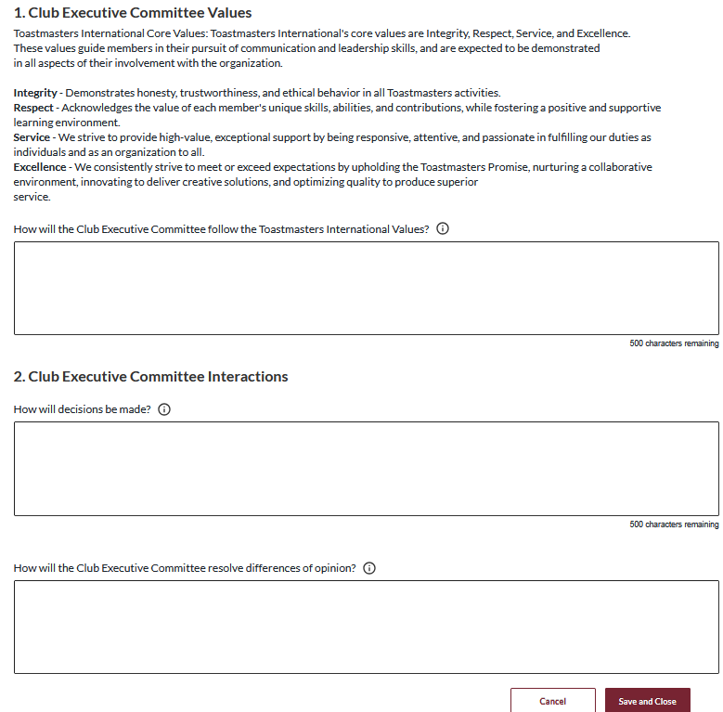

Slide 20
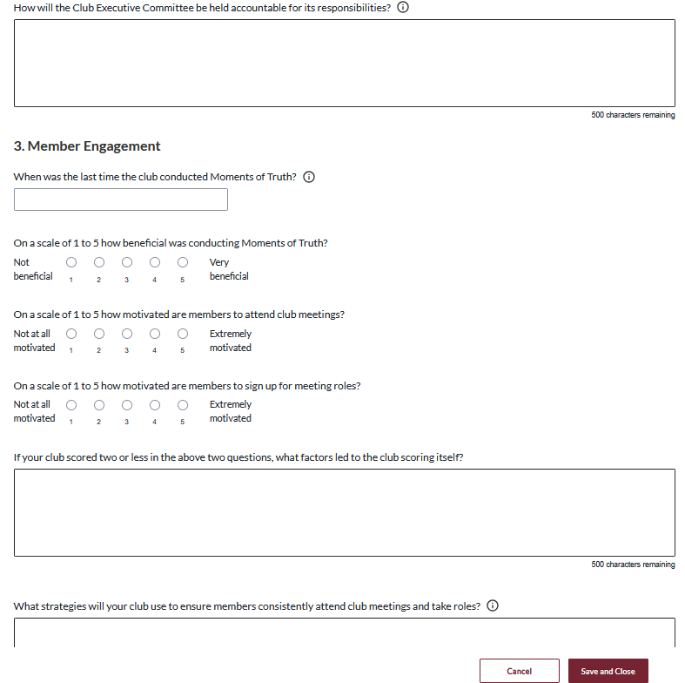

Slide 21
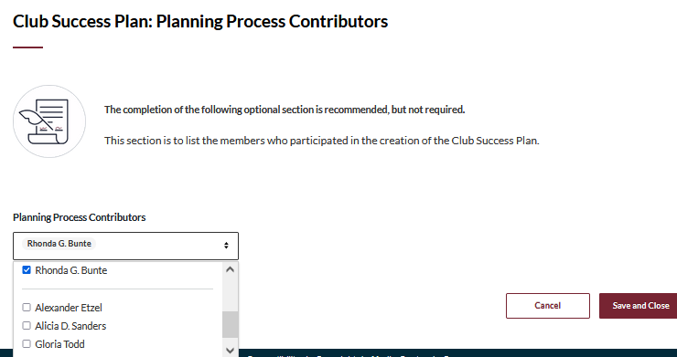
Club Officer Requirement Towards DTM
Notes:
Presenter informs attendees: The participation in the prep of the CSP when the member is a club officer is a requirement for any member working towards a DTM. Club officers can present the final CSP at a club meeting or any and all members can participate in the prep of the CSP so that all members are engaged in the club's success towards Distinguished Club or better.

Slide 22
CLUB SUCCESS PLAN ACTIVITY
Club Scenario
Club has 10 members.
Officers are brand new and unsure where to start.
President say club wants to grow and get back to being a President’s Distinguished Club.
Questions
What’s ONE goal this club should include in its CSP?
What’s ONE action step the officers can take?
How can the Area Director help?

Slide 23
Additional Resources
Distinguished Club Program and Club Success Plan
https://www.toastmasters.org/resources/resource-library?t=1111
Distinguished Performance Reports (Dashboard)
https://dashboards.toastmasters.org/
Moments of Truth
https://www.toastmasters.org/resources/moments-of-truth
Quick Guide to the Dashboard Layout
https://dashboards.toastmasters.org/docs/Dashboard%20Guide.pdf
Notes:
Presenter informs attendees: The participation in the prep of the CSP when the member is a club officer is a requirement for any member working towards a DTM. Club officers can present the final CSP at a club meeting or any and all members can participate in the prep of the CSP so that all members are engaged in the club's success towards Distinguished Club or better.

Slide 24
What is one thing you learned from this session that you will implement in your club?

Slide 25
Session Assessment
Go to link in Chat
You have 5 minutes

