Slide 1
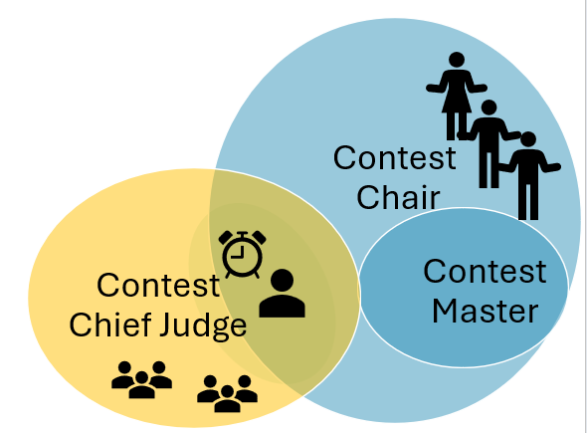

Contest Chair Briefing of
Contestants and Helpers
Spring 2026
Notes:
For Contest Chairs for Area Contests, Division Contests, and District Contests too – make yourself a copy

Slide 2
Contest Briefing for Date Time Contest at Location
Briefing Agenda | For Area XX / Division XXXXXXX
Introductions | Introduce Contest Chair (Director, organizer), Contest Master (Toastmaster of the contest), Contest Chief Judge
Location Logistics for Contest Day | Note Time to arrive. Registered? Meeting Room/ Entrance/Parking area. Parking pass, if needed? Share Phone # for Contest Day with Contest Chair
Briefing Break-outs | Briefed by
Contestants | Contest Chair with Contest Master
Sergeants at Arms | Contest Chair. also arrange for contestants’ props
Timers | Contest Chair - show contestants timing signals Contest Chief Judge – on timing logistics
Ballot Counters | Contest Chief Judge
Notes:
Use this a few days before the Contest to prepare all contestants and helpers

Slide 3
Contestant Briefing
Confirm all contestants, Speakers’ Certification of Eligibility and Originality forms for each contest (Evaluation and International Speech).
Make sure all contestants and test speaker have provided legible Speech Contestant Profile Biographical Data forms to the Contest Chair, then given to the Contest Master.
Review key points from the Contest Rulebook
Originality – no more than 25% of another’s work
Do not refer to another contestant or their speech content
Verify the speech title of each speaker and the pronunciation of their names with Contest Master.
Contestants will be introduced as follows: Contestant# (walk to center stage), Evaluation Contest, state their name TWICE. International Speech Name; Speech Title; Speech Title; Name.
Notes:
Links to forms available on D50 Contest webpage; see Rulebook, notably p. 9 for Originality requirement

Slide 4
Contestant Briefing: Timing
Timers will be located directly in front of the stage. Timing Cards will be used.
Evaluation: 2- 3 minutes
Speeches less than 1:30 (one minute, thirty seconds) or more than 3:30 (three minutes, thirty seconds) will be disqualified
Timing Cards will be shown:
Green Card at 2 min. Must remain displayed for 30 seconds.
Yellow Card at 2 min, 30 seconds. Must remain displayed for 30 seconds.
Red Card at 3 min. Must remain on display until the conclusion of the evaluation.
International Speech: 5 – 7 minutes
Speeches less than 4:30 (four minutes. thirty seconds) or more than 7:30 (seven minutes, thirty seconds) will be disqualified
Timing Cards will be shown:
Green Card at 5 min. Must remain displayed for 1 minute.
Yellow Card at 6 min. Must remain displayed for 1 minute.
Red Card at 7 min. Must remain on display until the conclusion of the speech.

Slide 5
Contestant Briefing - continued
Timers will be located directly in front of the stage. Timing Cards or signaling device will be used (as noted on prior slide).
Time starts with the first word uttered or non-verbal communication by the contestant.
There will be one minute of silence between each speaker for judging activities. Come to the side of the stage at this time.
Arrange for props in advance with Contest Chair. A Sergeant at Arms will place them on the stage during the minute of silence.
No name badges, educational indicators, or Toastmaster pins of any kind can be worn by the contestants. Please remove those prior to joining the contest.
Evaluation Contestants observe a 5-to-7-minute test speech and then deliver a 2-to-3-minute evaluation of that speech.
Note sheet will be provided to each contestant for taking notes. (Evaluation Contest ONLY)

Slide 6
Contestant Briefing - Disqualifications/Logistics
Disqualifications can ONLY be made for the following:
Time - Chief Judge and Timers. if there is a disqualification for time, it will be announced (no name) before the announcement of the winners.
Originality – Voting Judges and/or Contestants may protest to the Chief Judge or the Contest Chair, prior to the contest being adjourned. Protests are limited to eligibility, originality, and reference to another contestant or another contestant’s speech.
Eligibility - must be a paid member of a club in good standing, a new, dual, or reinstated member must have dues and membership application current with World Headquarters, and not a district officer or candidate for a district office.
For International Speech, must have completed a level 2 or higher in the Pathways program, or have Distinguished Toastmaster (DTM) status, or be a charter member in the first year of a new club
Note: Once a winner has been declared, all decisions are final. The Chief Judge and Ballot Counters can correct the Contest Chair if he reads the winners incorrectly.
Speaking Area - Speakers will have a defined speaking area. For the District Contest, this is marked with tape on the stage to ensure that they are viewable by the cameras.
International Speech at District Contest will be recorded. The Contest Chair will have forms at the contest for you to complete to give consent. If ANY contestant is being recorded, then ALL contestants must sign the form as acknowledgement, even if not being recorded.

Slide 7
Contestants – Draw for Speaking Order
Evaluation:
International Speech:
Notes:
Draw for Speaking Order. Suggest random.org for List randomizer.

Slide 8


Slide 9
Contest
Role Holder Briefing
Spring 2026

Slide 10
Sergeant at Arms
Each contest will have a minimum of two (2) Sergeants at Arms. Plan for one at each door + one more to escort evaluation contestants.
For each entrance, one Sergeant at Arms ensures that the entrance is secure during the contest, maintains order and good behavior.
When each contest begins, latecomers must wait outside the room. Let people into the room only during the minute of silence, or after all contestants have completed their speeches.
One Sergeant at Arms assists the Contest Chair and ContestMaster as needed.
Escort Contestants and Set up Props, as needed, during the one minute of silence between contestants

Slide 11
Timers
Verify timers are from different clubs
Discuss timing logistics with Timers at the front of the room
Provide timing sheets and timing cards or signaling device
Use stopwatches or confirm timing app on a smartphone
Timing begins with the first word or deliberate gesture deemed part of the speech
If cards are used, hold the card up the entire time until the card color changes. For the last (red) card, the card is to be held up until the end of the speaker’s presentation.
Timing for each contest.
Evaluation Speech: 2 green, 2:30 yellow, 3 red
International Speech: 5 green, 6 yellow, 7 red
Notes:
Slide 1 of 2 for Timers

Slide 12
Timers - continued
DO NOT indicate disqualification in any way
Time the One Minute of Silence - At one minute show the red light or card
After all speakers have spoken for each contest, both timers sign/initial the Timing Sheet
Give the Timing Sheet to the Chief Judge ONLY
DO NOT discuss timing results with the contestants or anyone else
Notes:
Slide 1 of 2

Slide 13
Ballot Counters
Ballot Counters are to collect (5 ballots for Area Contests, and a minimum of 7 for Division and District).
After all contestants have spoken, stand up and be ready to collect the ballots.
Do not hover around judges.
Collect ballots and indicate to the Chief Judge how many you have.
For Example, hold up a finger for each ballot you have collected
Once all ballots have been collected, go with the Chief Judge and tally the ballots
DO NOT DISCUSS RESULTS WITH ANYONE.
ALL RESULTS ARE TO REMAIN CONFIDENTAL.

